Slide 1
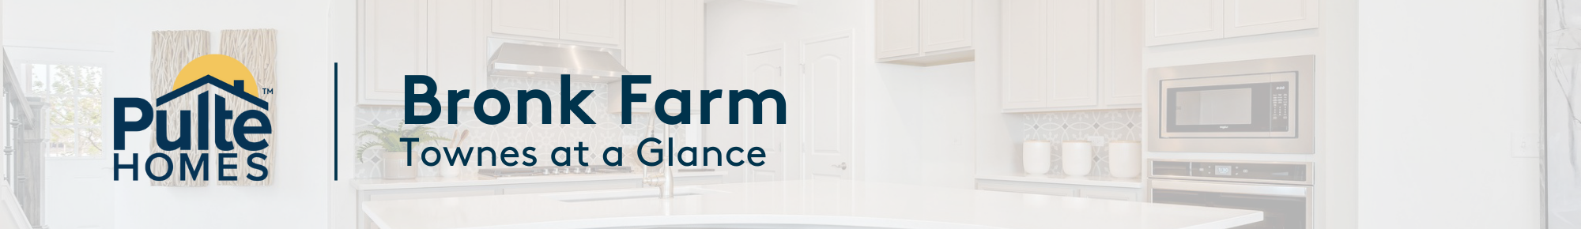


Liberty Junction
Libertyville
BUILDING-UNIT | FLOORPLAN | BED/BATH | SQ. FT. | DESIGN UPGRADES | ESTIMATED COMPLETION | PURCHASE PRICE
10-2 | Halston (MIDDLE UNIT) | 3 Beds-2 Full Baths-2 Half Baths | 2,219 | High End Designer Upgrades throughout the home. MOVE IN READY | January | $577,495
10-3 | Halston (MIDDLE UNIT) | 3 Beds-2 Full Baths-2 Half Baths | 2,219 | High End Designer Upgrades throughout the home. MOVE IN READY | January | $580,068
10-4 | Jayton (END UNIT) | 3 Beds-2 Full Baths-2 Half Baths | 2,357 | High End Designer Upgrades throughout the home. MOVE IN READY | January | $633,545
7-1 | Jayton (END UNIT) | 3 Beds-2 Full Baths-2 Half Baths | 2,357 | High End Designer Upgrades throughout the home. | April | $647,050
7-2 | Halston (MIDDLE UNIT) | 3 Beds-2 Full Baths-2 Half Baths | 2,219 | High End Designer Upgrades throughout the home. | April | $584,028
7-3 | Halston (MIDDLE UNIT) | 3 Beds-2 Full Baths-1 Half Bath | 2,219 | High End Designer Upgrades throughout the home. | April | $577,185
7-4 | Jayton (END UNIT) | 3 Beds-2 Full Baths-2 Half Baths | 2,357 | High End Designer Upgrades throughout the home. | April | $643,722
6-2 | ISELTON (MIDDLE UNIT) |  |  |  |  | SOLD
6-3 | ISELTON (MIDDLE UNIT) |  |  |  |  | SOLD
*Prices subject to change without notice.
Contact: Lindsay Goff @ lindsay.goff@pulte.com or 847-630-2152

